Slide 1
What is a Web Service:
Acc to w3c, web service is a software system designed to support inter-operable machine to machine interaction over a network
3 keys
Designed for machine-to-machine interaction/ or app to app interaction
Interoperable irrespective of technology
Allow communication over a network

Slide 2
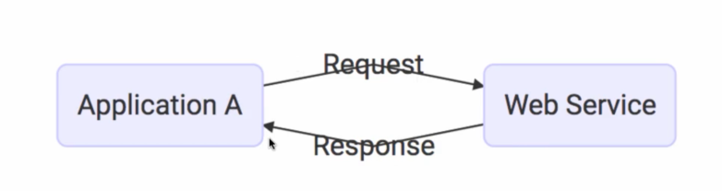
How???
How does the data exchange takes place among WS?
Using Request and Response
How can we make web service platform independent
Using xml
Using json
How does application A knows the request and response.
Answer is Service definition which is provided by each web service

Slide 3
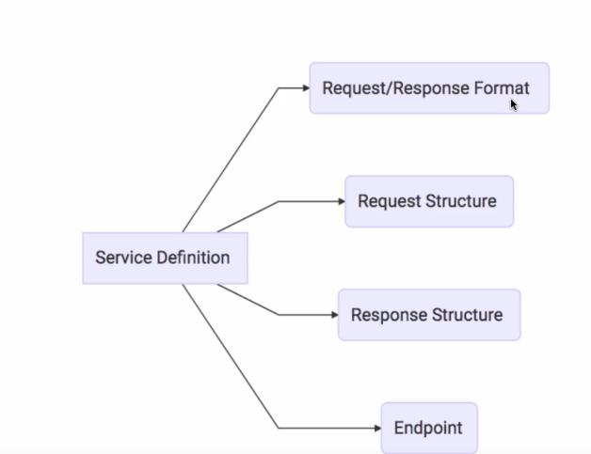

Slide 4
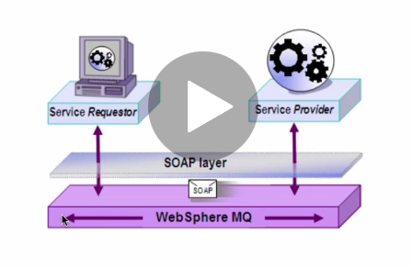
Terminologies
Request
Response
Service Provider
Service Consumer(application that is consuming WS)
Service Definition(contract between service provider and service consumer
Transport(How service is called)
Http, MQ

Slide 5
Web Services Group
SOAP and REST
What is SOAP?
Stands for simple object access protocol.
A soap message is contained in an envelope .
In SOAP,
FORMAT OF DATA :-
SOAP xml request
SOAP xml response
TRANSPORT
HTTP
MQ
SERVICE DEFINITION
WSDL

Slide 6
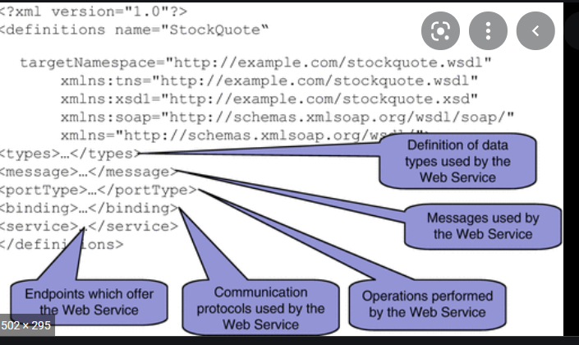
WSDL
It Defines all the operations
It Defines the endpoints
It defines the Request/Response Structures

Slide 7
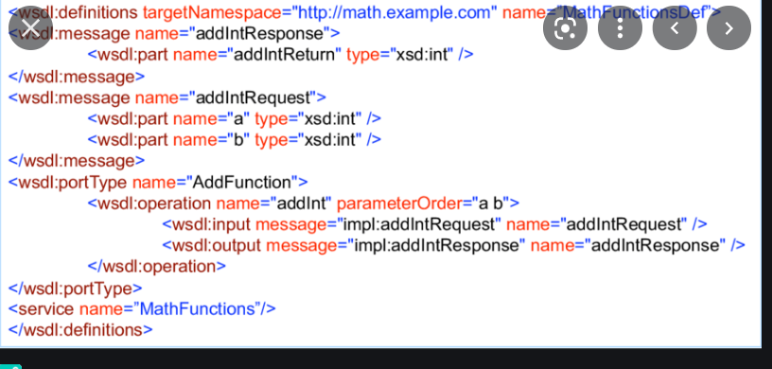
Soap message

Slide 8
REST
Stands for Representational State Transfer
It makes use of HTTP Methods
REST
HTTP
HTTP methods like GET,PUT,POST | HTTP Status code like 200(Success), 404

Slide 9
REST
Data Exchange Format
No Restriction, JSON is a popular one
Transport
Only Http
Service Definition
There is no standard for service definition. Swagger is a popular one though

Slide 10
SOAP VS REST
SOAP is restriction on XML where as REST is architectural
Data Exchange format is strict in SOAP(xml) which is not in REST. However JSON is popularly used
Service Definition
WSDL in Soap
No standard service definition in rest. Most popular is Swagger. WADL is less used.
Transport
In Soap, we can used web(http) or MQ.
Rest makes use of Http
Ease Of Implementation
Easy in Rest as we don’t have have service definition
In SOAP we need to have service definition which is addon work , apart from xml parsing

